Slide 1
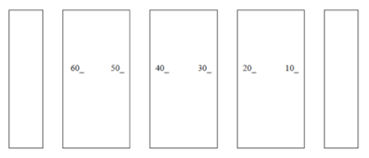
Experiments:
What’s My Formula?, Nomenclature & Molecular Modeling
Chem 108: Lab
Week 8
Sign in; Sit with Group.
Front of Lab
A
B
C
D
E
F
G
Work with the groups from last week’s lab.

Slide 2
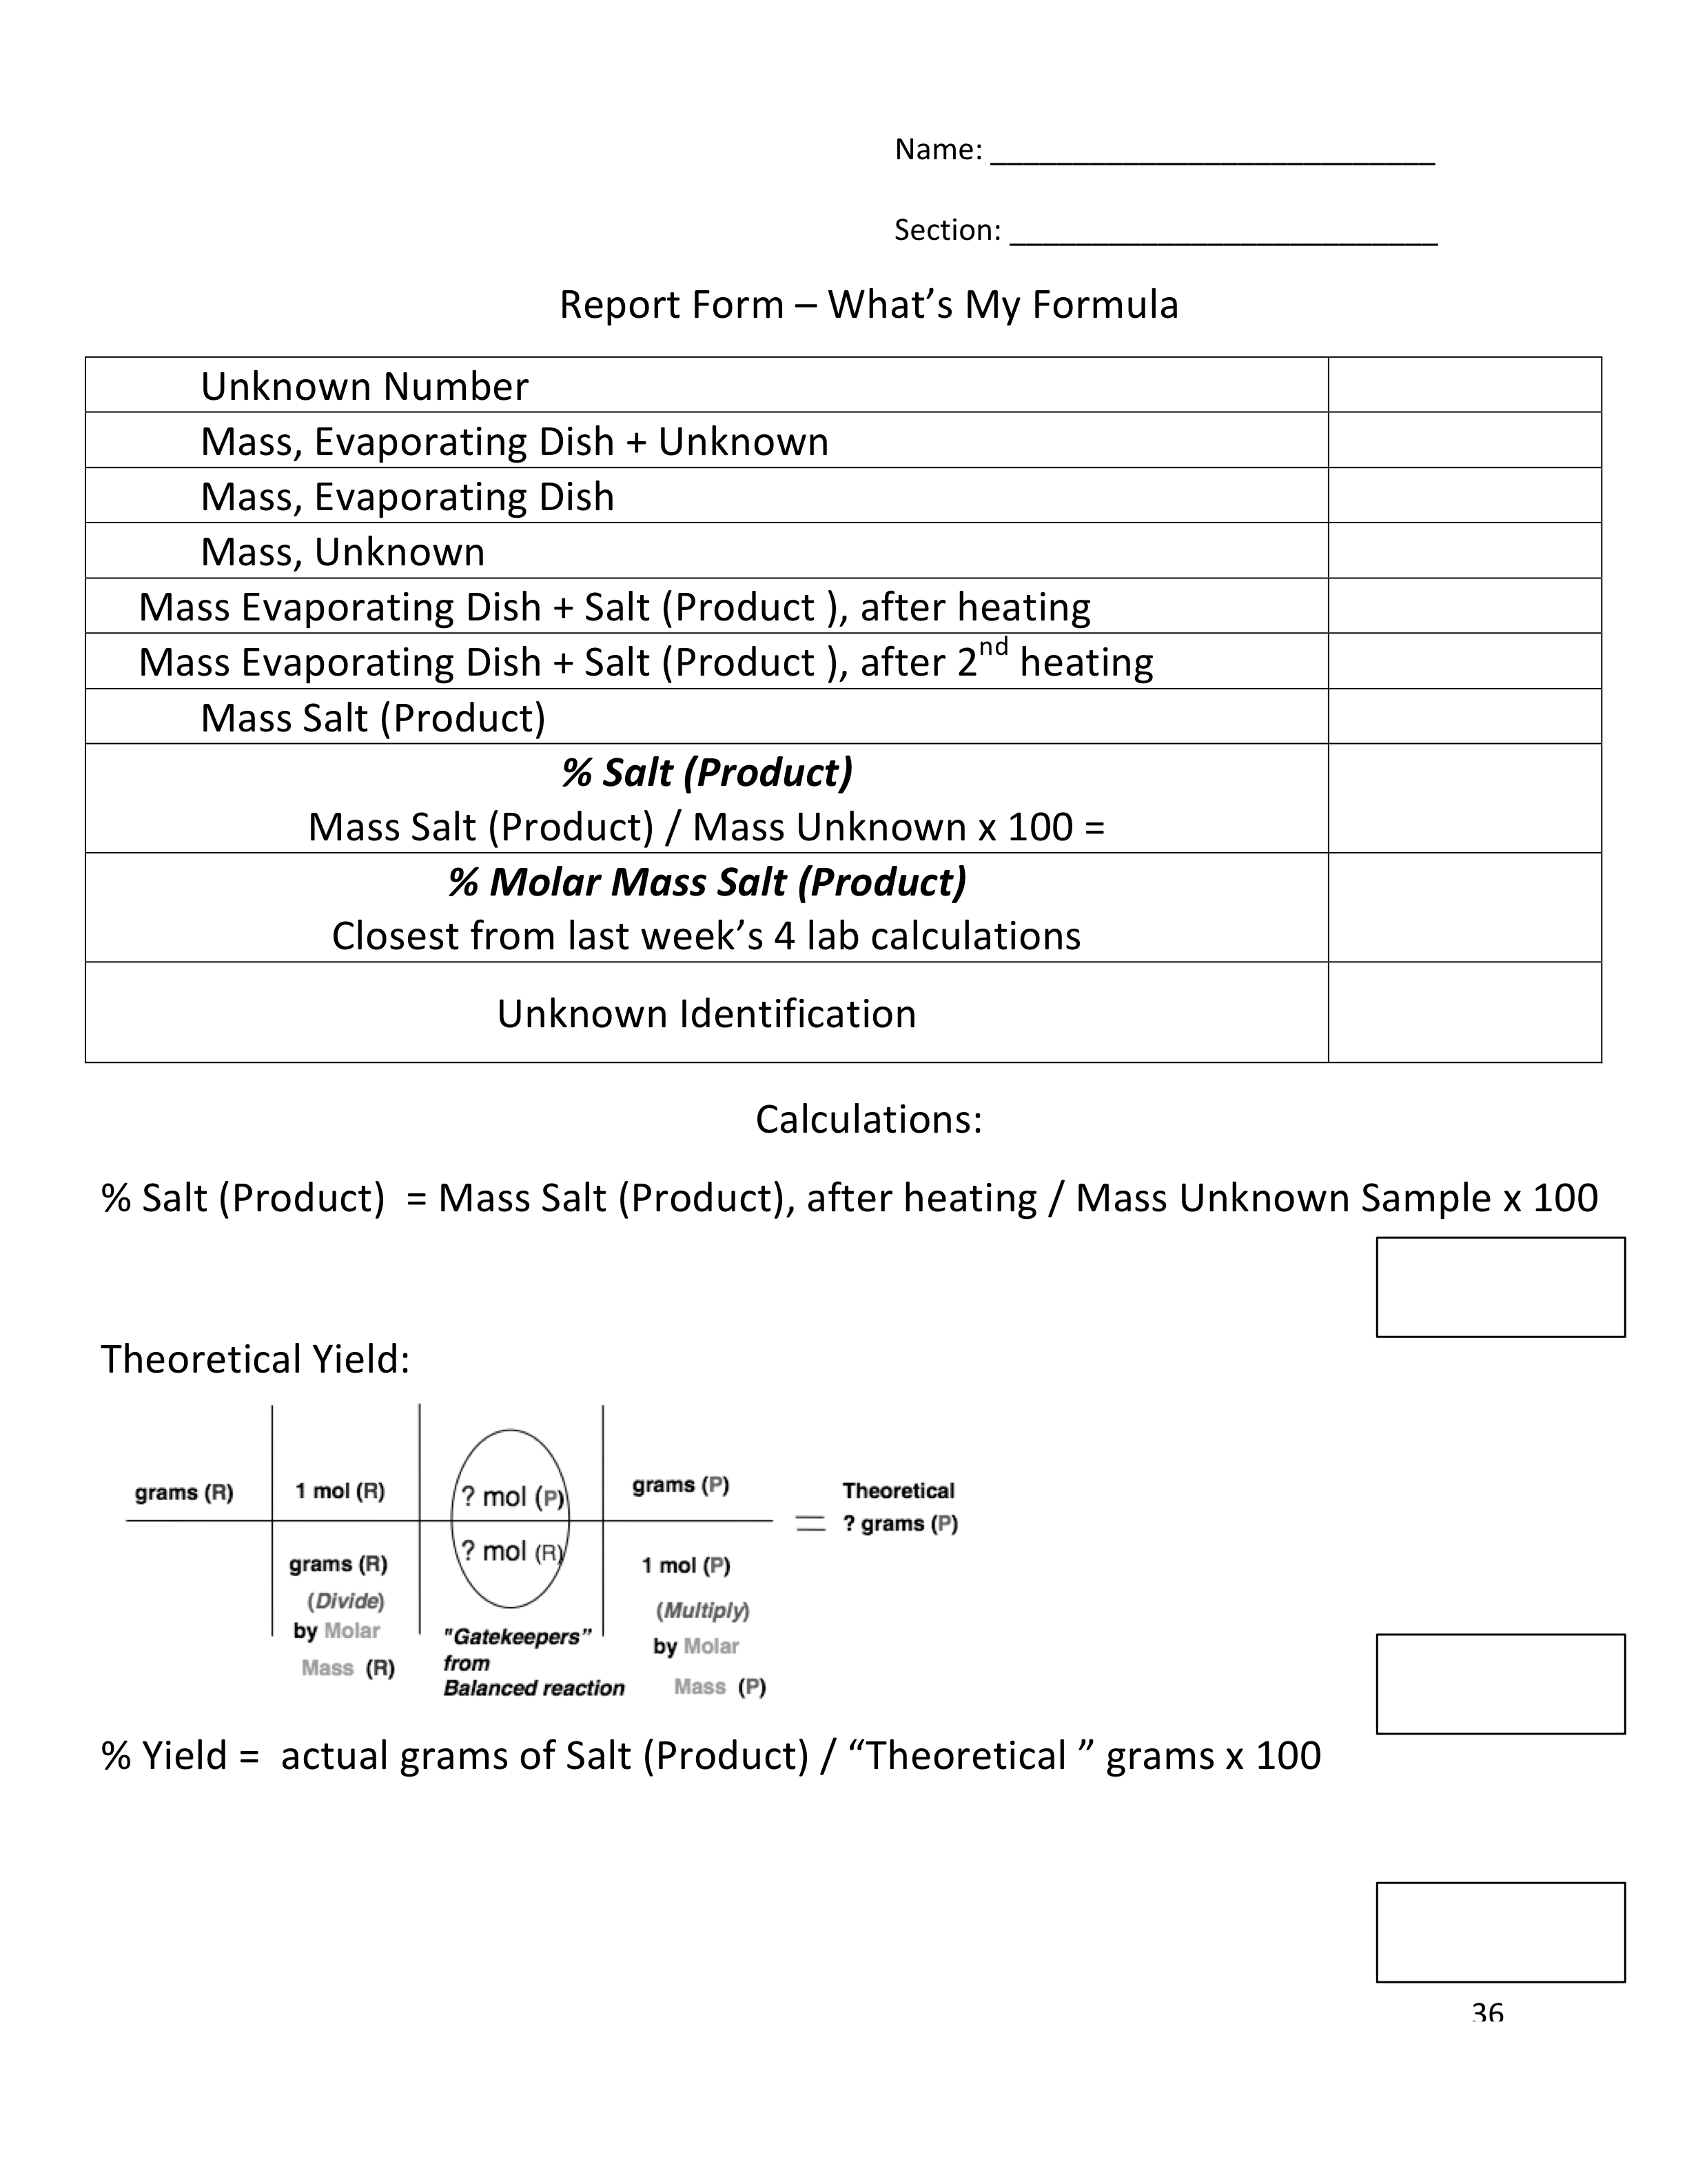
What’s My Formula?
Your work group has 2 to 5 unknowns. Complete the experimental procedures and submit one complete report form the unknown worked on, with partner(s)’ name(s) on the data form page & a complete set of clear calculations for each unknown with % Yield & Theoretical Yield Calculations
(replacement for pg. 36)
Have data signed before leaving.
Complete Report Forms
DUE Next Lab

Slide 3
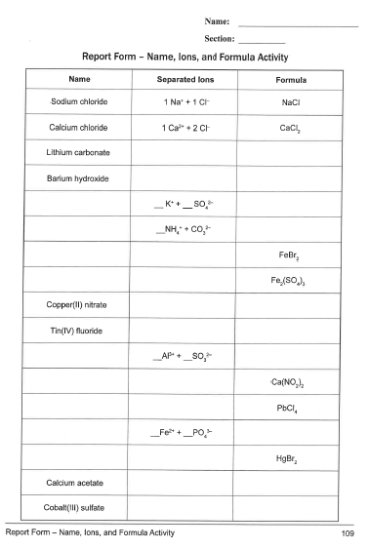
DUE 25-Mar
Nomenclature
Names, Ions, Formulas
Complete Report Form
pp. 109-114
1 form per lab group:
With names of only those
who contributed on
the form.

Slide 4
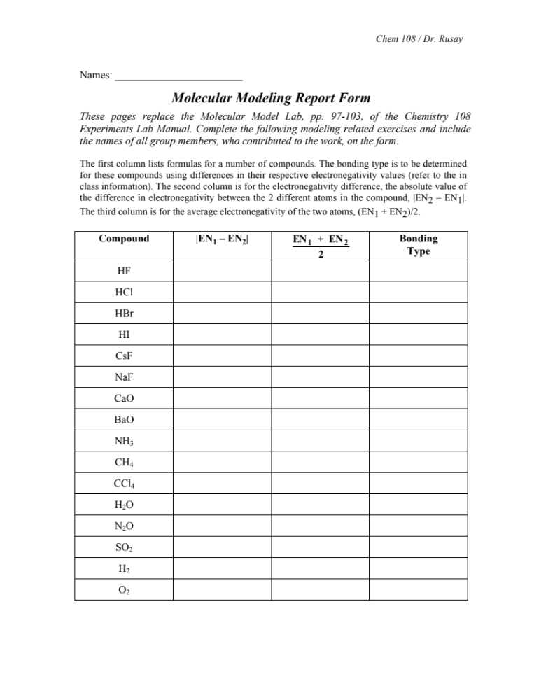
Bonds: Molecular Shapes: Molecular Modeling
http://molview.org
Have completed first & second pages checked
before leaving lab.
Everyone is to complete their own form.
Notes:
A 3900-year-old clay tablet, which was found in Iraq between the Tigris and Euphrates rivers, had a Sumerian poem (http://www.piney.com/BabNinkasi.html) honoring Ninkasi, the patron goddess of brewing. It contains the oldest surviving beer recipe, describing the fermentation of the carbohydrates found in bread, bappir, made from barley, honey, dates and sweet aromatic herbs. The global availability of carbohydrates and native microbes (yeasts) has led to the production of many different types of beers, ales, wines, and fruit based alcoholic beverages in many countries throughout the world. [The bottle on the left was found in Eugene, Oregon, ……. But, it dates only to 2016.]

Slide 5
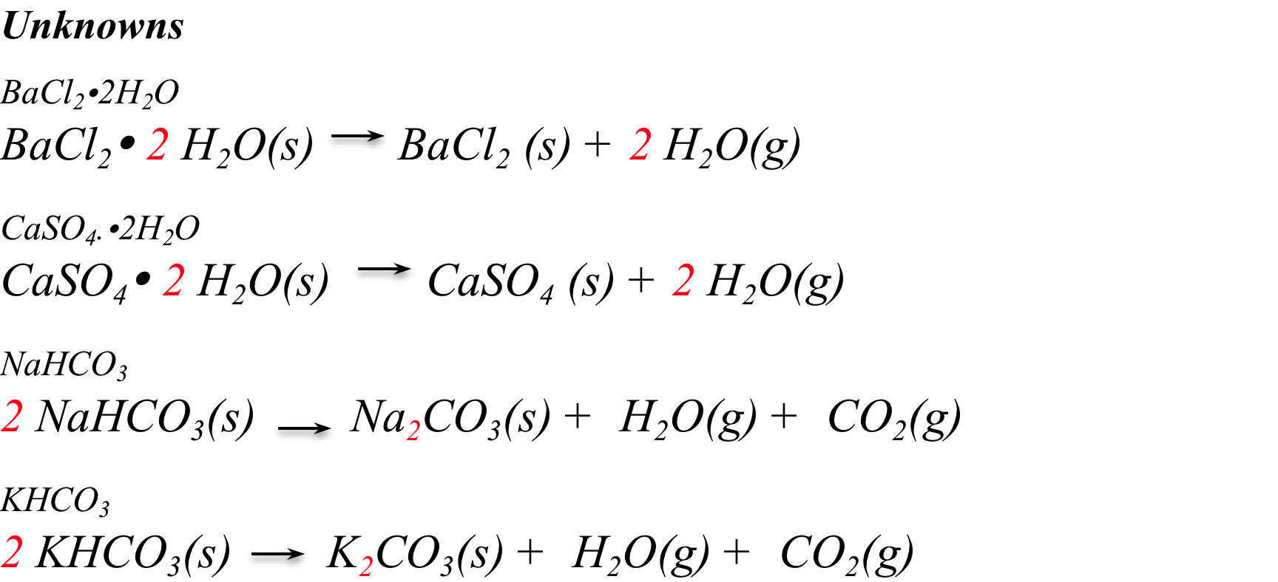
What’s My Formula? Identificaton
85.26%
Unknown Sample
Salt
79.09%
Unknown Sample
Salt
63.08%
Unknown Sample
Salt
69.02%
Unknown Sample
Salt
Experimental Calculation:
Comparison to Calculation(s) for a, b, c, d FROM last week:
?
?

Slide 6
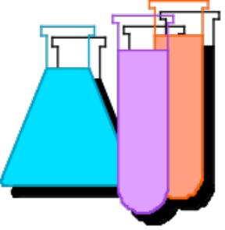
Theoretical Mass Calculations for any Reaction
Reactants Products
grams (Reactant)
grams (Product)
Moles
Molar Mass
grams (R)
1 mol (R)
? mol (P)
grams (P)
? grams (P)
? mol (R)
grams (R)
1 mol (P)
(Divide)
Mass (R)
(Multiply)
Mass (P)
by Molar
"Gatekeepers”
from
Balanced reaction
by Molar

Slide 7
What’s My Formula?
% Yield (Example)
Heating 10.00 g of an unknown determined to be sodium bicarbonate and actually obtaining 5.98 g of sodium carbonate. What is the Percent Yield?
First calculate the theoretical yield. (Adaptation of your calculations last week.)
It considers in the calculation that everything went perfectly, and is based on the assumption of 100% accuracy.
% Yield is actual; based on reality.
Reactant = 10.00 g
Molar Mass = 84.00 g/mol
Product = ? g (Theoretical)
Molar Mass = 105.99 g/mol

Slide 8
Theoretical Mass Calculations
Reactants Products
Moles
grams (Reactant)
grams (Product)
Molar Mass
”Mole Gatekeepers”
from
Balanced reaction
10.00 grams
(NaHCO₃)
1 mol
(NaHCO₃)
? mol
(Na₂CO₃)
105.99 grams
(Na₂CO₃)
? mol
(NaHCO₃)
? Theoretical grams
(Na₂CO₃)
84.00 grams
(NaHCO₃)
1 mol (Na₂CO₃)
(Divide) by
Molar Mass (NaHCO₃)
(Multiply) by
Molar Mass (Na₂CO₃)

Slide 9
Theoretical Mass Calculations
Reactants Products
”Mole Gatekeepers”
from
Balanced reaction
10.00 grams
(NaHCO₃)
1 mol
(NaHCO₃)
1 mol
(Na₂CO₃)
105.99 grams
(Na₂CO₃)
2 mol
(NaHCO₃)
6.31 grams
(Na₂CO₃)
84.00 grams
(NaHCO₃)
1 mol (Na₂CO₃)
(Divide) by
Molar Mass (NaHCO₃)
(Multiply) by
Molar Mass (Na₂CO₃)

Slide 10
What’s My Formula?
“% Yield” is used to measure the efficiency (similar to “accuracy”) of any reaction in yielding “product(s)” (on the right of an equation) versus the calculated (theoretical) amount of the product based on the amount of “reactant(s)” (from the left of the equation) using the relative number of moles of each in a balanced chemical equation.
% Yield =
actual grams of product / theoretical (calculated) grams of product x 100
For example, heating 10.00 g of sodium bicarbonate and actually obtaining 5.98 g of sodium carbonate. After calculating the theoretical yield:
Reactant = 10.00 g
Molar Mass = 84.00 g/mol
Product = 6.31 g (Theoretical)
Molar Mass = 105.99 g/mol
% Yield = 5.98 g (actual) / 6.31g (theoretical) x 100
= 94.6%

Slide 11
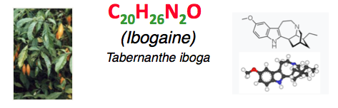
QUESTION
A synthetic reaction produced 2.45g of Ibogaine, C₂₀H₂₆N₂O, a natural product with strong promise in treating heroin addiction, the calculated theoretical yield was 3.05g, what is the % yield?
A) 19.7% B) 39.4% C) 80.3% D) 160.6%

Slide 12
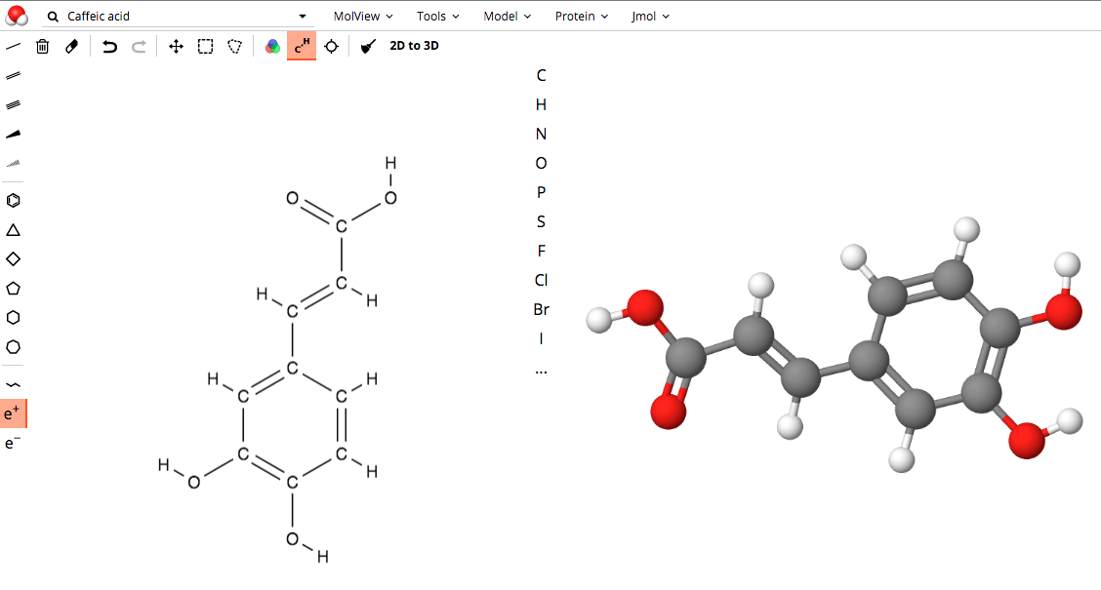
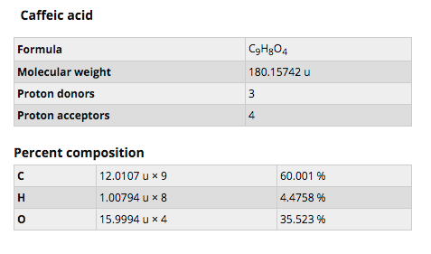
Post Lab: Molar Comparisons of Analgesics
[ eg. C₉H₈O₄ ]
Dosage Calculations: (mmol/dose vs. grams/dose)
Which analgesic has the most biologically active ingredient based on millimoles per dose (mmol/dose)?
5.0 g of the active ingredient would produce the following number of doses:
Formula Doses mmol/dose
  Aspirin C₉H₈O₄ 15.0
  Ibuprofen C₁₃H₁₈O₂ 25.0 ?
  Naproxen Sodium C₁₄H₁₃O₃Na 22.7 ?
  Acetaminophen C₈H₉NO₂ 5.0 ?
1.8 mmol/dose
Molar Mass Aspirin = 180.1 g/mol
5.0 g / 180.1 g/mol = 0.028 mol/15 doses = 1.8 mmol/dose

Slide 13
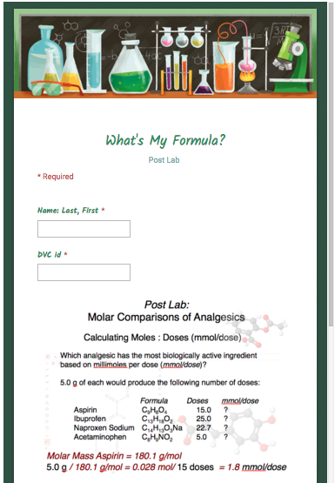
Molar Comparisons of Analgesics
Calculate Moles : Doses (mmol/dose)
Post Lab:
Must submit Individually
From calendar link
DUE
Next Lab

